Slide 1

NORTH WESTERN UNIVERSITY, KHULNA
Hotel Management System
Course Tittle: Software Development Sessional III
Course Code:CSE-3204

Slide 2

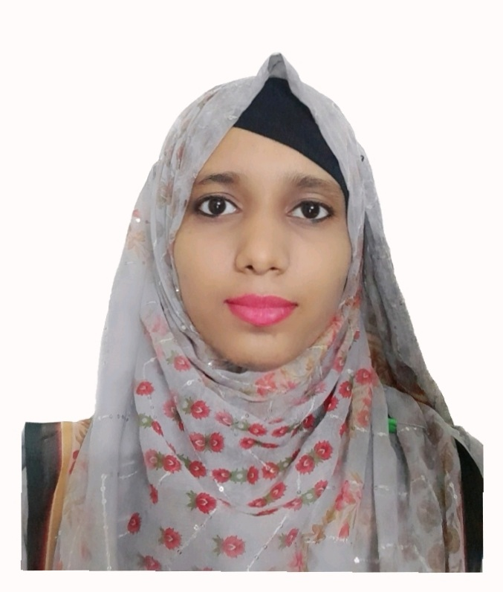
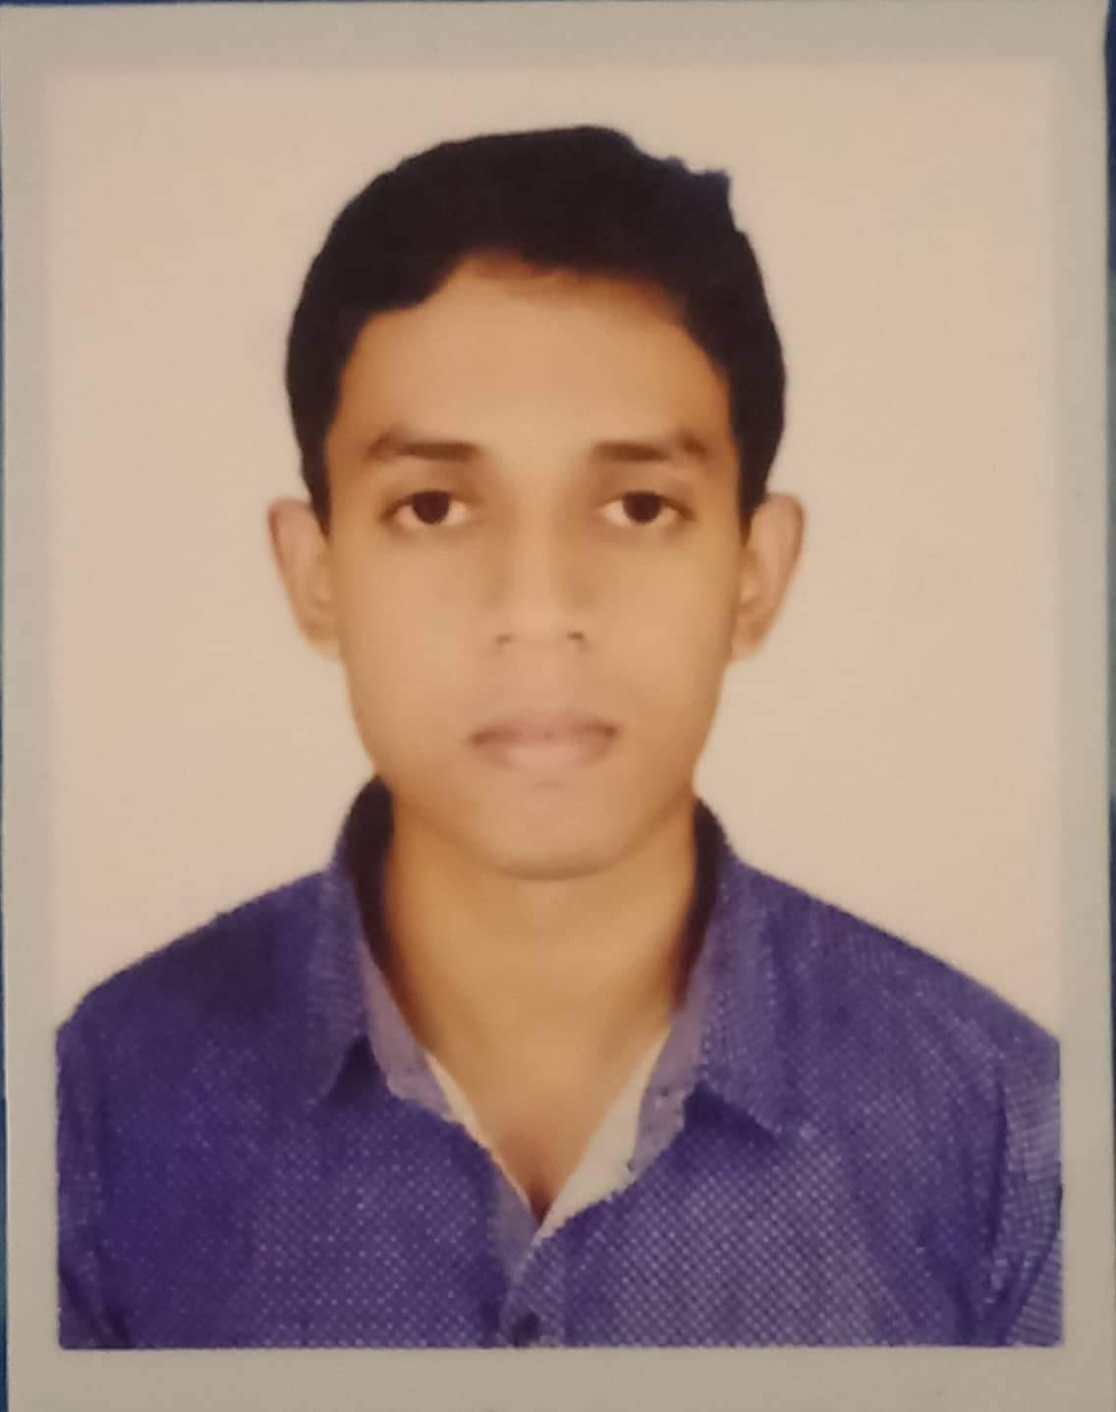
2
Team Name
NWU_HMS
Details Of Team Members
Istiak Khan
Student
Id:20201114010
Department Of CSE
North Western University
Khulna, Bangladesh
Mashuka Yeasmin
Student
Id:20201113010
Department Of CSE
North Western University
Khulna, Bangladesh
Samiul Hasnat Sazin
Student
Id:20201123010
Department Of CSE
North Western University
Khulna, Bangladesh

Slide 3
3
Overview
Introduction
Objective
E-R Diagram
Site Tree
Project View
Login pages
Admin Mode
Receptionist Mode
Customer Mode
Dependencies

Slide 4
4
Introduction
Software developed by python using tkinter module to handle the basic functions of a hotel process.
To add new information, update information, view information, delete information , search particular information and others process.
Helps to provide information to admin, stuff and customer.

Slide 5
5
Objectives
To eliminate the huge storage of data paper by storing data into Database.
Simplify search and update process of hotel.
To manage customers information and his booking and paying details.
Build Digital official interface to maintain official work digitally.
Simply Calculate the customer's bill.

Slide 6
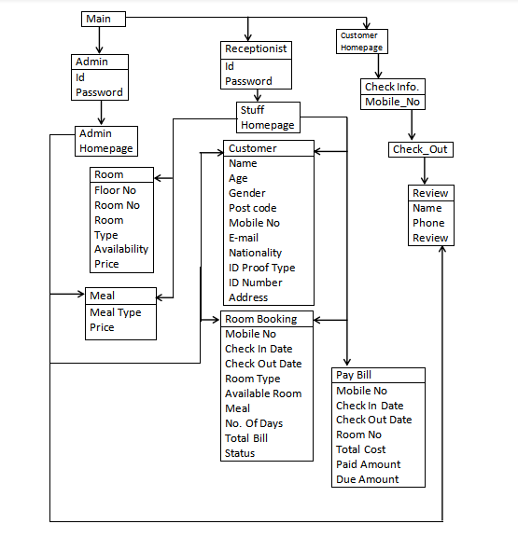
6
Entity Relationship Diagram
Figure: E-R Diagram of HMS

Slide 7
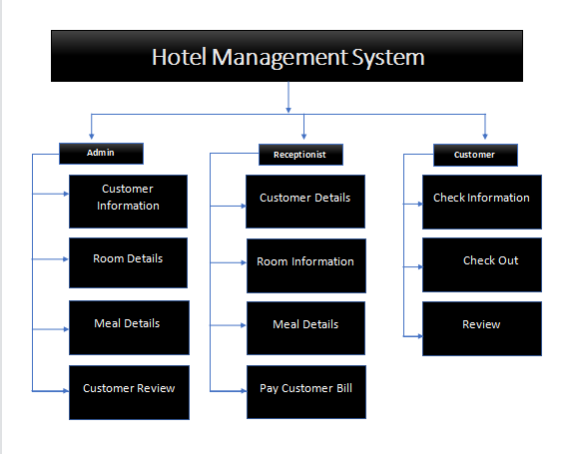
7
Site Tree
There are three characters: Admin, Receptionist and Customer. Each character has unique view and their own activities.

Slide 8
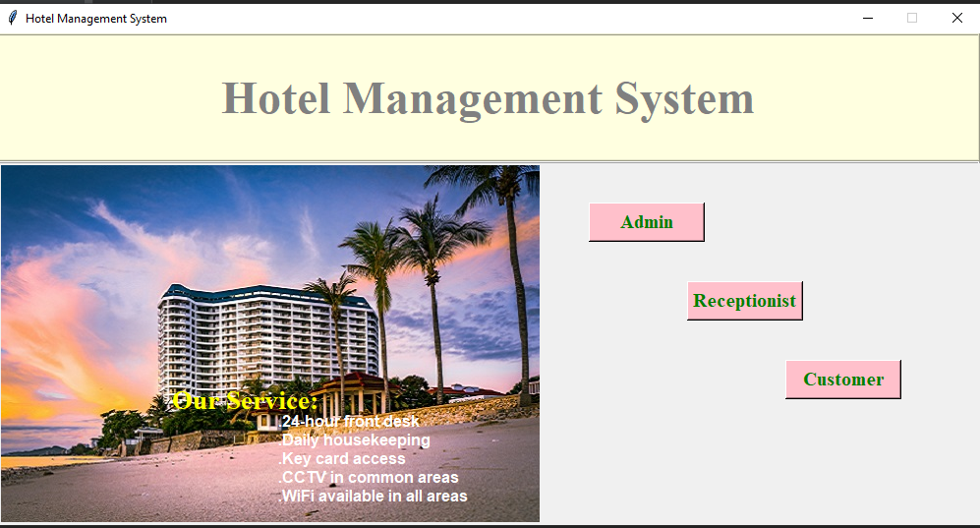
8
Project View
Home Page of Hotel Management System

Slide 9
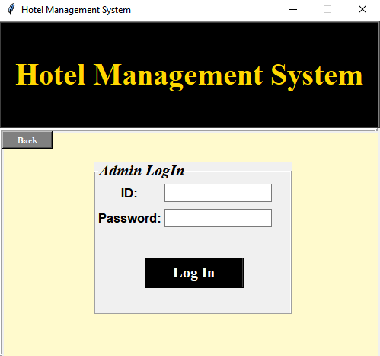
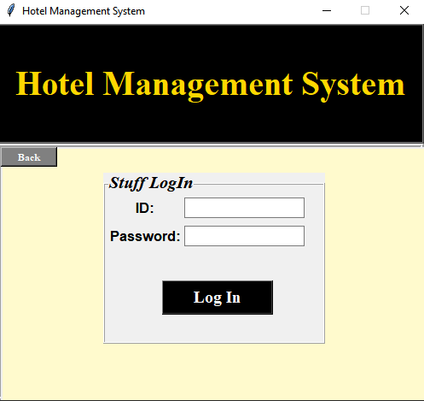
9
Login Pages
Admin Login Page
Receptionist Login Page

Slide 10
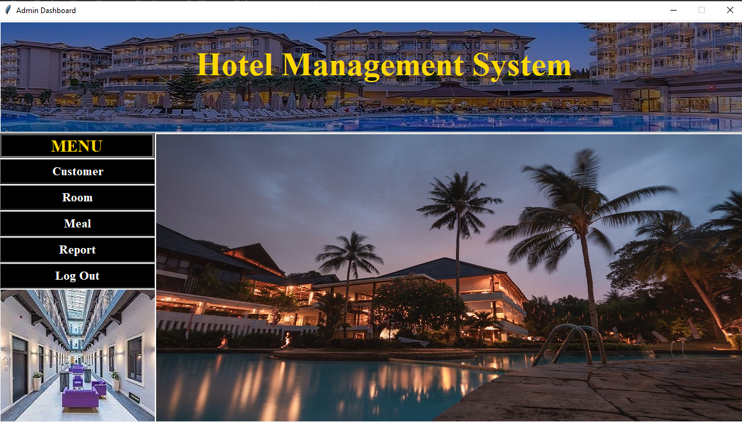
10
Admin Mode
Login successfully, an Admin can view the Admin Dashboard of the Hotel Management System.
An Admin can view customer information, their review and also add, view, update, delete the information of rooms and meals.

Slide 11
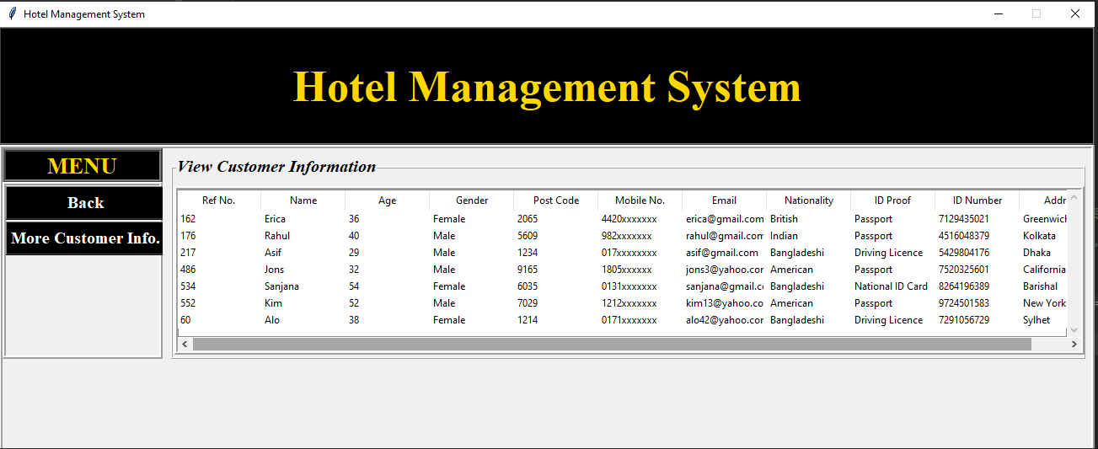
11
Clicking Customer, the Admin will be able to view the Customer information

Slide 12
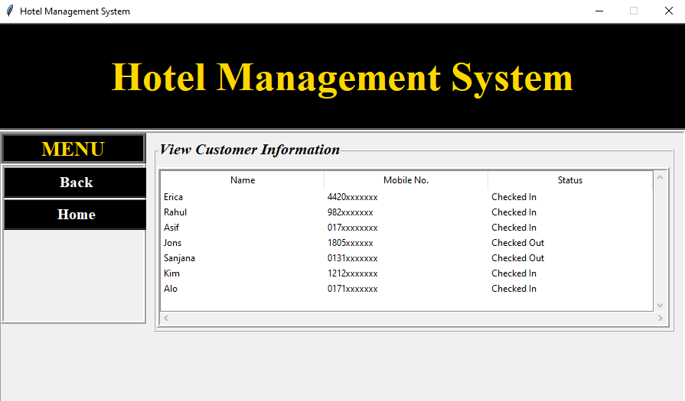
12
Clicking More Customer Info., the Admin will be able to view more information about customer

Slide 13
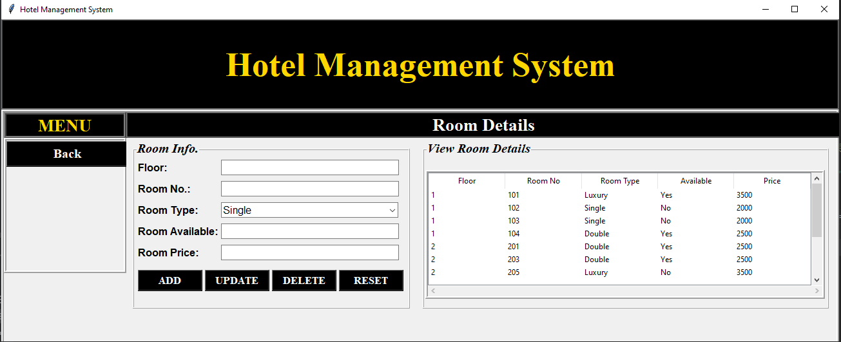
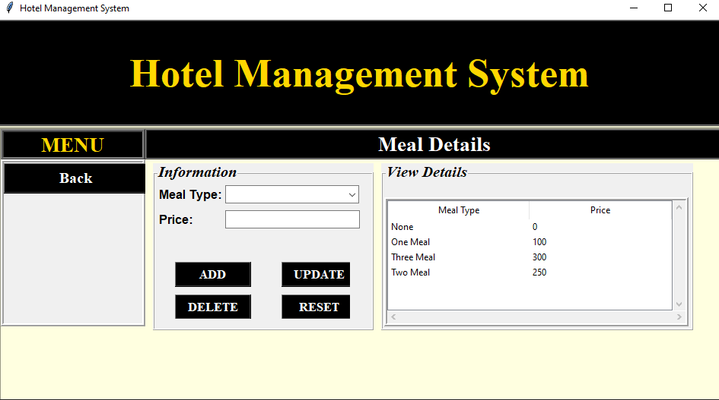
13
Clicking on Room, the Admin will be able to add, update, view and delete information about rooms
Clicking on Meal, the Admin will be able to add, update, view and delete information about meals

Slide 14
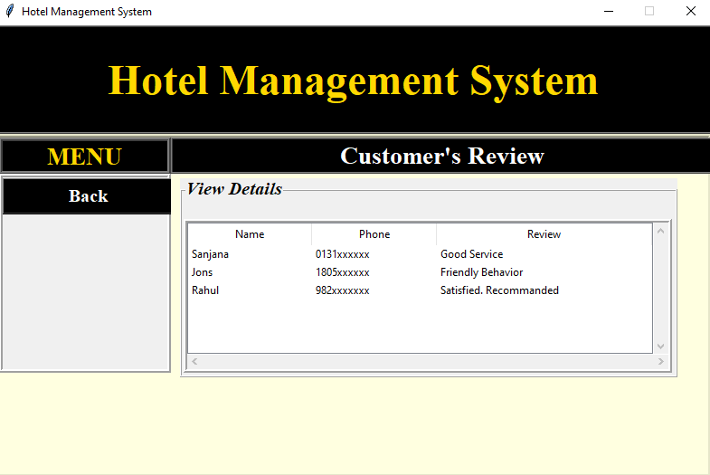
14
Clicking on Report, the Admin can view the customers’ review

Slide 15
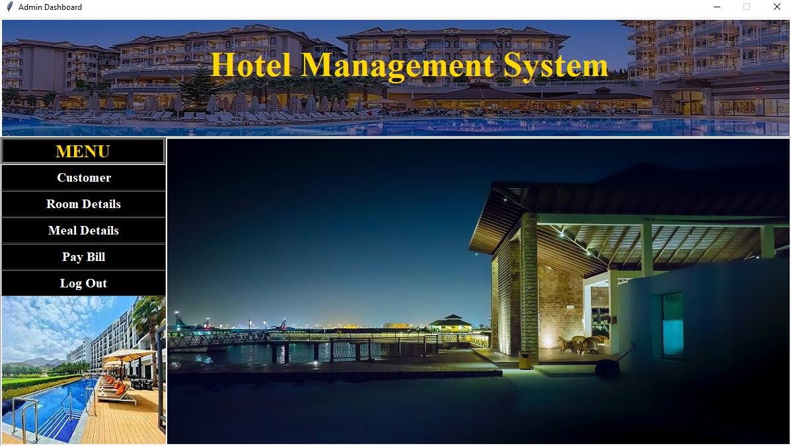
15
Receptionist Mode
Login successfully, a Receptionist can view the Stuff Dashboard of the Hotel Management System.
A Receptionist can add, view, update, delete customer information, and update their bill. They also view the information of rooms and meals.

Slide 16
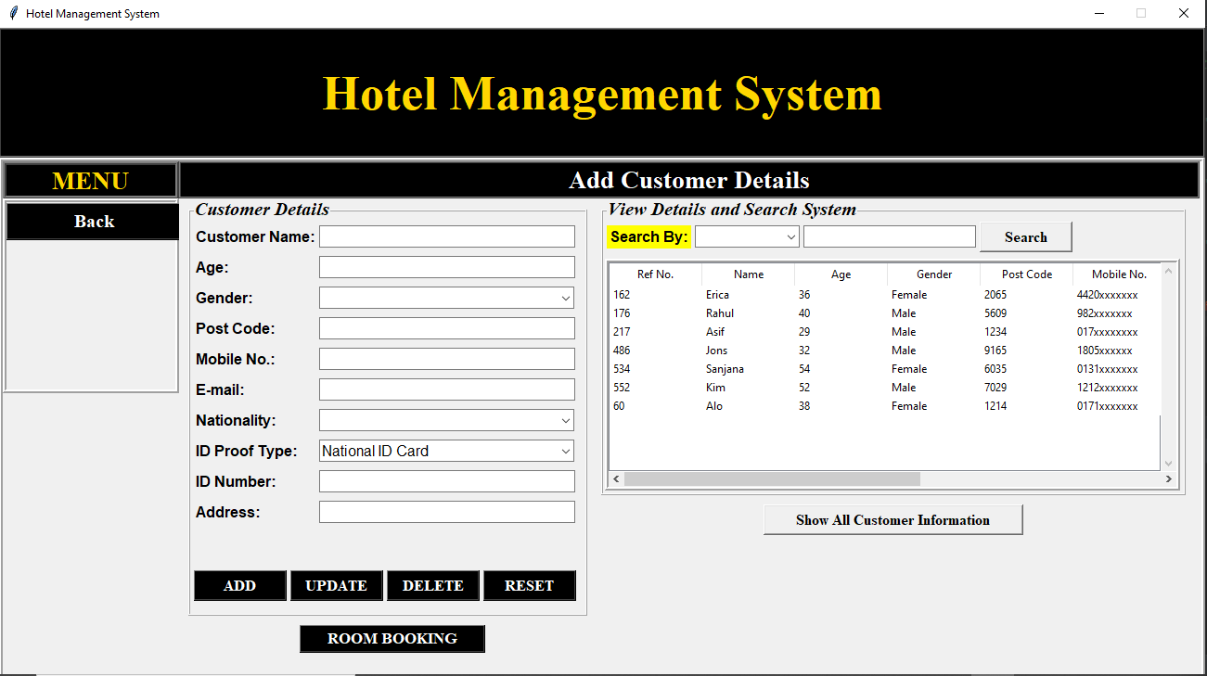
16
Clicking on Customer, the Receptionist will able to add, update, delete, view the Customers’ basic information

Slide 17
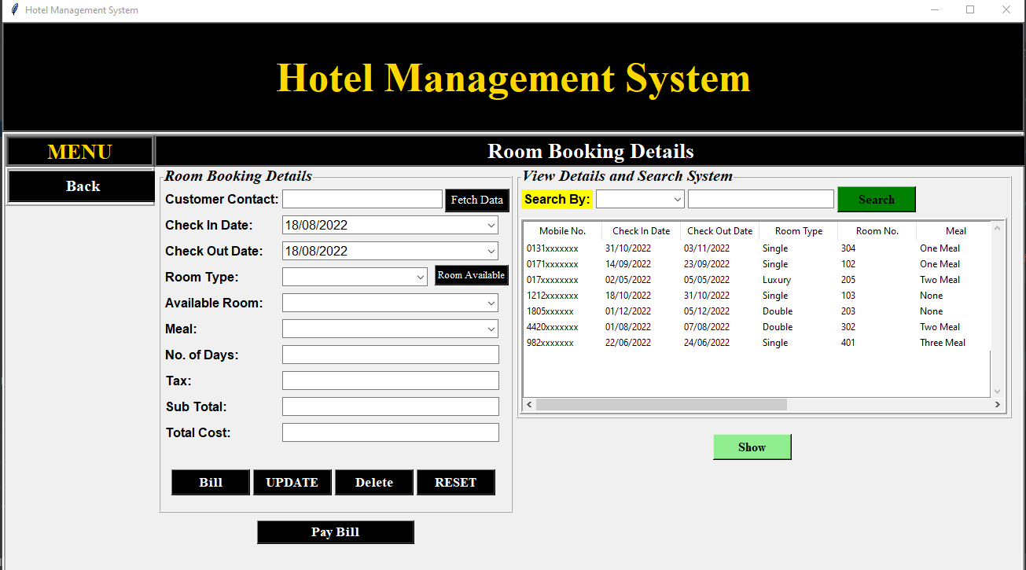
17
Clicking on Room Booking, the Receptionist will able to add, update, delete, view the Customers others information

Slide 18
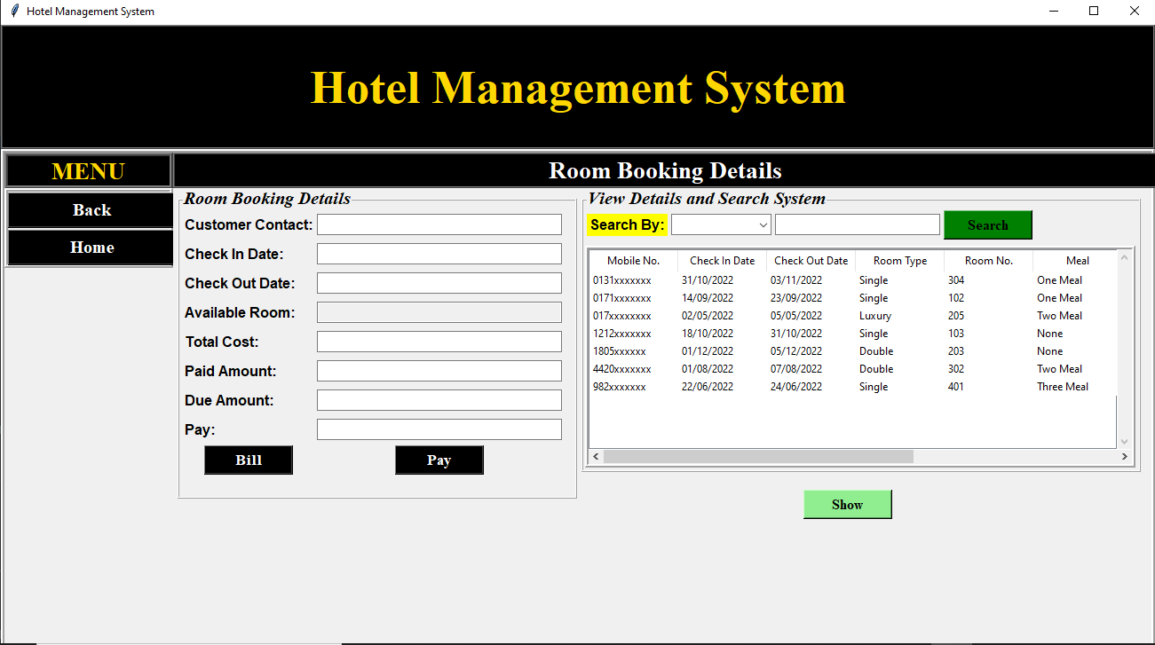
18
Clicking on Pay Bill, the Receptionist will able to update and view the Customers’ billing information

Slide 19
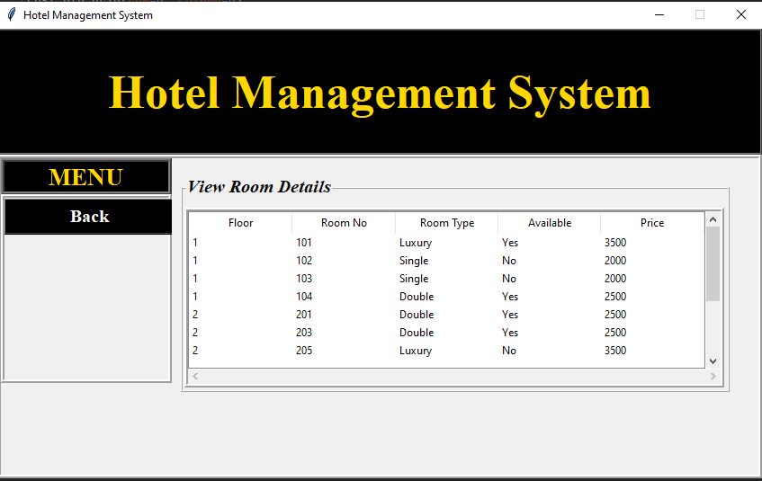
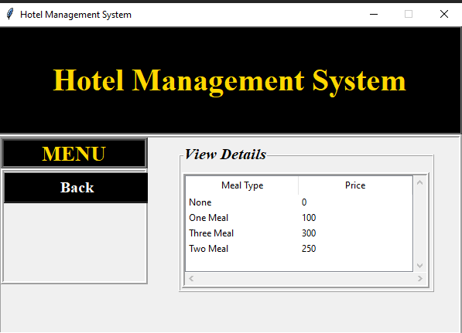
19
Clicking on Room Details, the Receptionist will only able to view the rooms information
Clicking on Meal Details, the Receptionist will only able to view the meals information

Slide 20
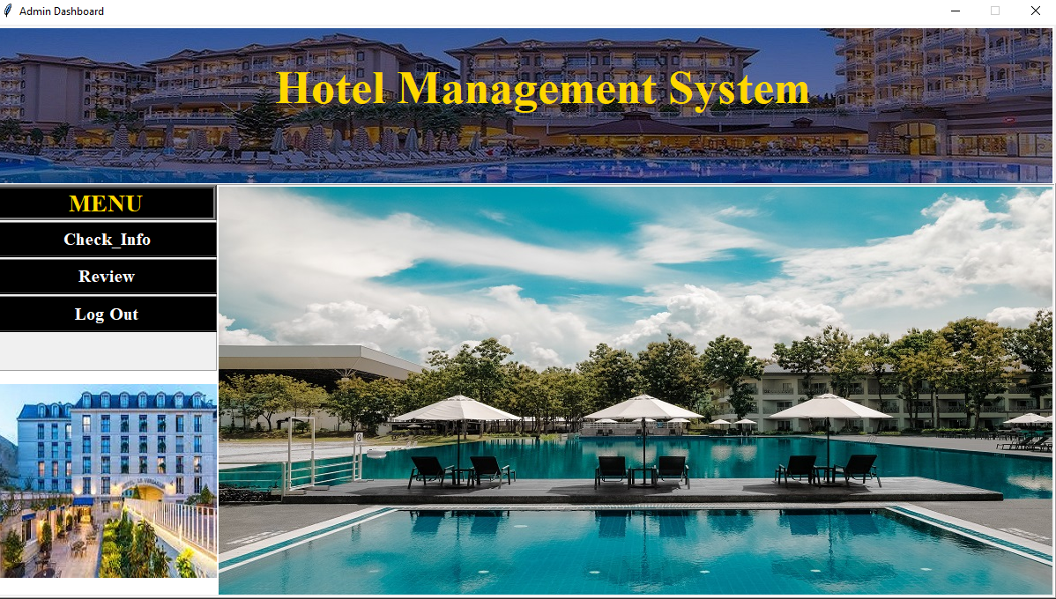
20
Customer Mode
From Home Page, cliking on Customer, a customer can view the Customer Dashboard.
Able to view own information, check out and give review

Slide 21
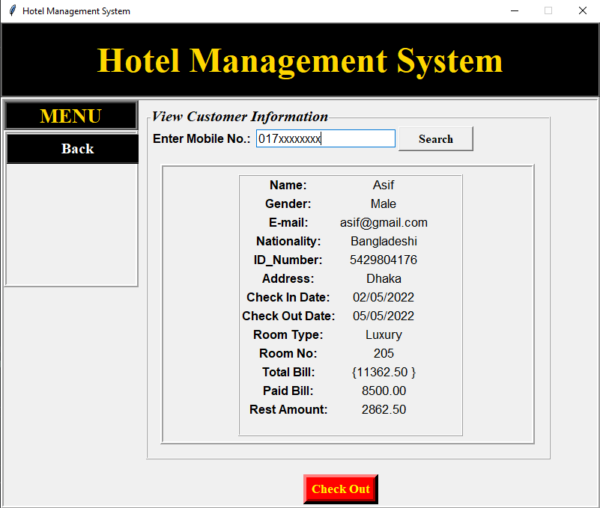
21
Ciking on Check_Info, a customer can view his information by giving his Mobile No.

Slide 22
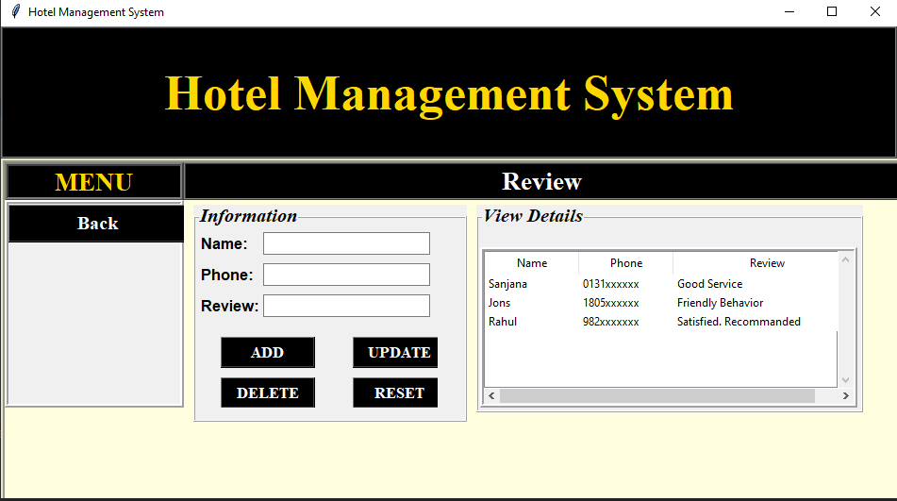
22
Cliking on Review, a customer can add, update, delete and view reviews

Slide 23
23
Dependencies
Xampp: The Hotel Management system (HMS)’s database is Store in local server. So xampp software is needed to run this project properly
Pycharm: For built this project, Python language and Python Built in Packages are used.
Tkinter: Used Python Tkinter Module for the User Interface.

Slide 24
24
Thank You

